Slide 1
CE 4361 Highway Engineering
Disruptive Technologies & Infrastructure
Subasish Das

Slide 2
Recent Research
Autonomous Delivery Vehicle as a Disruptive Technology: How to Shape the Future with a Focus on Safety?
A SafeD UTC Project
Project webpage: https://safed.vtti.vt.edu/projects/autonomous-delivery-vehicle-as-a-disruptive-technology-how-to-shape-the-future-with-a-focus-on-safety/
GitHub Repo: https://github.com/subasish/AI_in_HighwaySafety/tree/main/Chapter%209/Code

Slide 3
Synopsis
The National Highway Traffic Safety Administration recently granted permission to deploy low-speed autonomous delivery vehicles (ADVs) on roadways.
Although the mobility of ADVs is limited to low-speed roads and these vehicles are occupantless, frequent stops and mobility among residential neighborhoods cause safety-related concerns.
There is consequently a need for a comprehensive safety impact analysis of ADVs.
This study examined the safety implications and safety impacts of ADVs by using novel approaches.
This research prepared several datasets such as fatal crash data, aggregated ADV trips and trajectories, and real-world crash data from the scenario design for an ADV-related operational design domain.
Association rules mining was applied to the datasets to identify significant patterns.

Slide 4
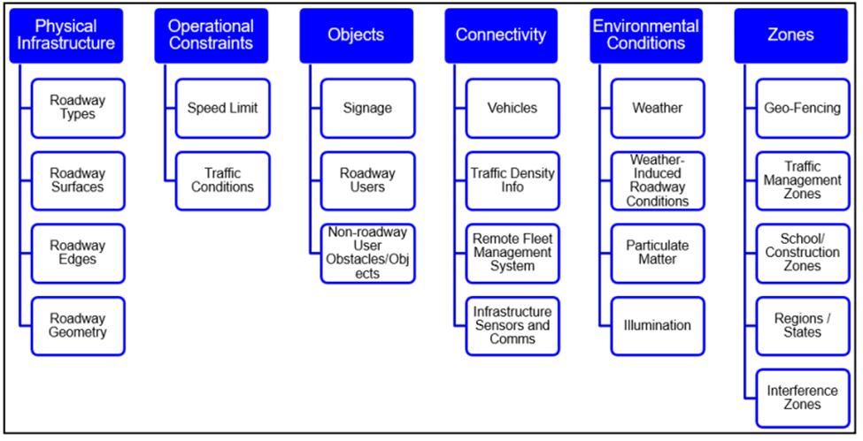
Operational Design Domain
Specific operating domains in which the CAV is designed to function.
May vary by OEM.
Infrastructure Owner Operator (IOO):
Physical infrastructure (e.g., pavements, bridges).
TCDs and other roadside infrastructure.
Transportation systems management and operations (TSMO) and ITS infrastructure.
Urban multimodal infrastructure.
Source: Thorn et al., 2018
OEMs are responsible for defining their ODD and assume responsibility for safe operations within the ODD regardless of IOO actions.

Slide 5
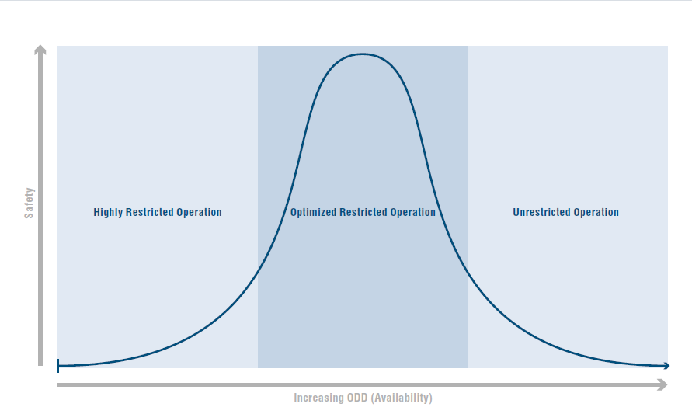
Operational Design Domain
The ability of IOOs to assist in defining ODDs is limited because ODDs are extremely complex and difficult and are proprietary to a company’s AV product and its ADS.

Slide 6
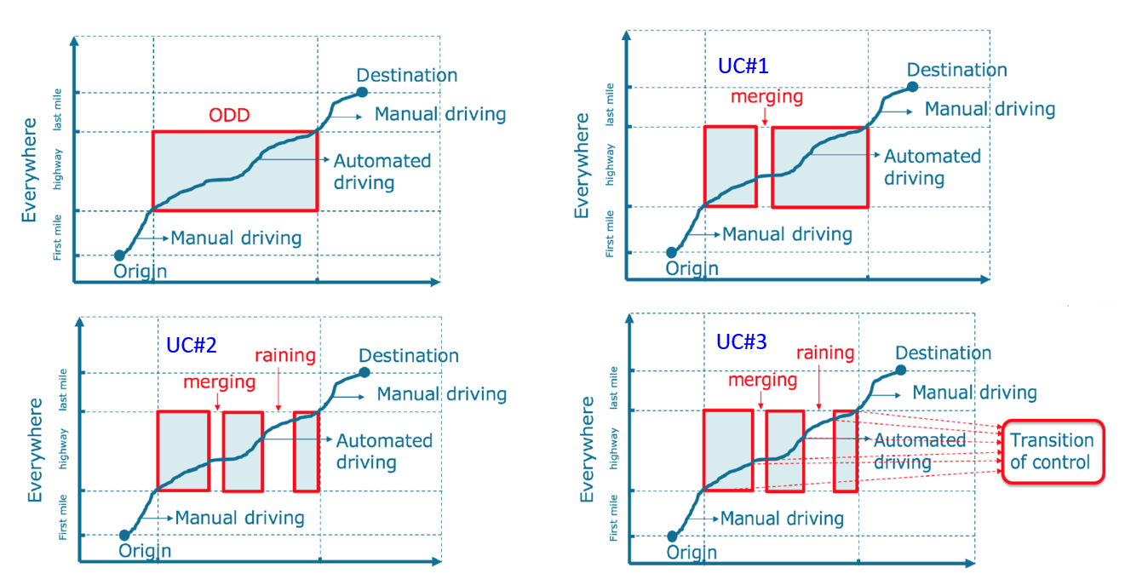
Use Cases

Slide 7
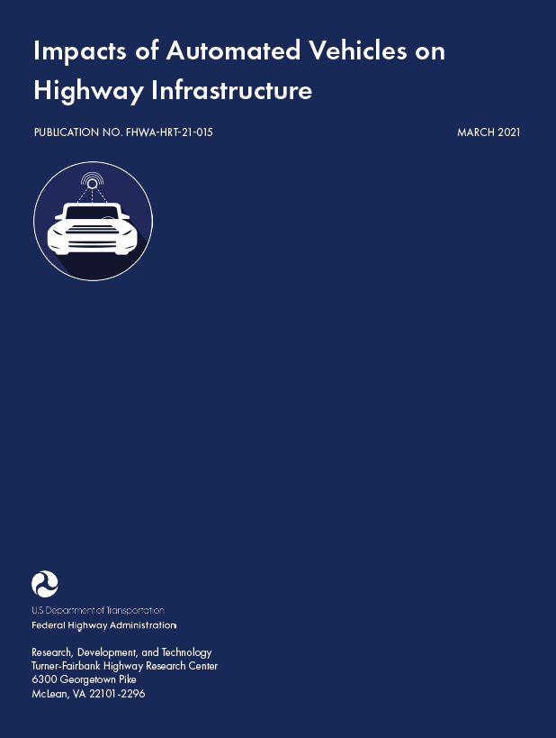
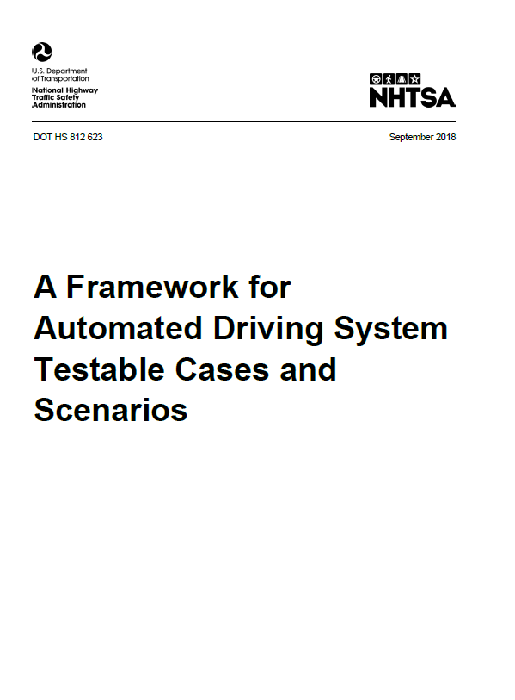
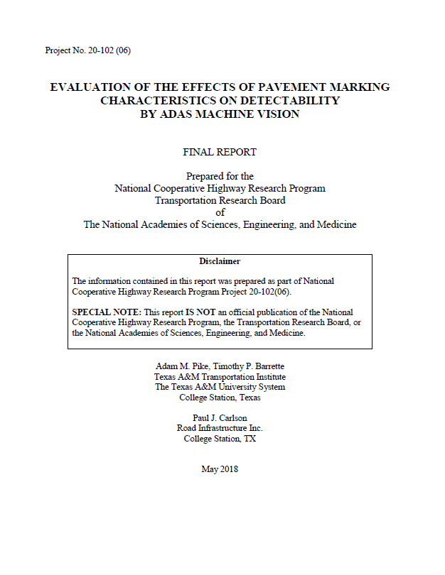
Reports on ODD+Infrasturucture

Slide 8
Datasets
Fatality Analysis Reporting System (FARS) [2016–2020]
Crash Report Sampling System (CRSS) [2016–2020]
California AV and ADV collision Data [2014–2020]
Waymo Open Data
Third-party ADV Trajectory Data (sample data)

Slide 9
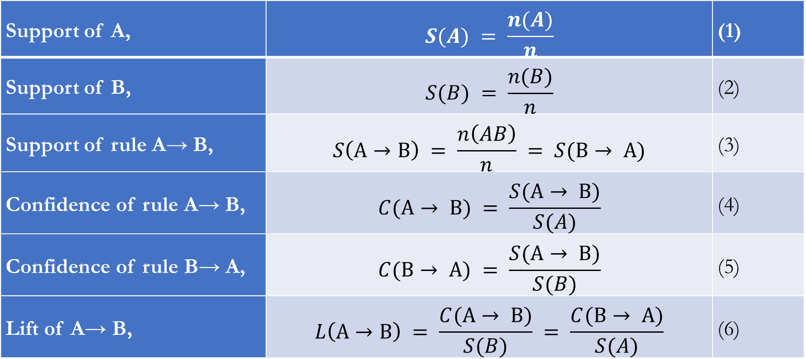
Association Rules Mining
Support of A, | $$S(A) = \frac{n(A)}{n}$$ | (1)
Support of B, | $$S(B) = \frac{n(B)}{n}$$ | (2)
Support of rule A→ B, | $$S\left(A→B\right) = \frac{n\left(AB\right)}{n} = S(B→ A)$$ | (3)
Confidence of rule A→ B, | $$C(A→ B) = \frac{S(A→ B)}{S(A)}$$ | (4)
Confidence of rule B→ A, | $$C(B→ A) = \frac{S(A→ B)}{S(B)}$$ | (5)
Lift of A→ B, | $$L\left(A→B\right) = \frac{C(A→ B)}{S(B)} = \frac{C(B→ A)}{S(A)}$$ | (6)

Slide 10
Understanding Rules Mining
For Intersection Related All Crashes:
Rule: Alcohol=yes, => dark_w/_streetlights
Crashes under Dark with continuous streetlights: 4,852
Crashes under Alcohol=Yes: 1087
Crashes under both dark with
continuous streetlights and
Alcohol=Yes : 441
Total Intersection related crashes= 32,940
Support= 441/32940=0.01
Confidence= 441/1087= 40.57%
Lift= (441/1087)/(4852/32940)= 2.75
Alcohol=Yes
Dark with Continuous Streetlight

Slide 11
Safety Implication Analysis
Functional Class | FARS | CRSS
ADV ODD Definition | Light vehicles and posted speed limit (less than 50 mph) and non-interstate roadways and vehicle models not older than 2000 | Light vehicles and posted speed limit (less than 50 mph) and non-interstate roadways and vehicle models not older than 2000 and non-fatal and non-property damage only
All Crashes (2016­–2020) | 172,237 | 259,077
ADV ODD Defined Crashes (2016–2020) | 37,692 | 55,221
All Vehicles Involved in Crashes (2016–2020) | 263,647 | 457,314
ADV ODD Defined Vehicles Involved in Crashes (2016-2020) | 43,683 | 73,440

Slide 12
FARS ADV ODD Scenarios
Crash Types | 2016 | 2017 | 2018 | 2019 | 2020 | Total
Not a Collision with Motor Vehicle | 3,916 | 4,003 | 4,169 | 4,005 | 4,328 | 12,088
Angle | 2,504 | 2,806 | 2,666 | 2,668 | 2,936 | 13,580
Front-to-Front | 996 | 1,017 | 1,079 | 1,075 | 1,129 | 5,296
Front-to-Rear | 516 | 556 | 599 | 487 | 530 | 2,688
Rear-to-Side | 17 | 4 | 6 | 8 | 10 | 45
Sideswipe | 272 | 304 | 300 | 283 | 317 | 1,476
Others | 47 | 35 | 35 | 28 | 32 | 161
Total | 8,268 | 8,725 | 8,854 | 8,554 | 9,282 | 43,683

Slide 13
FARS ADV ODD Scenarios
Rules | Antecedent | Consequent | Supp. | Conf. | Lift | Count
R#01 | Coll = Front-to-Front, Int = Not an Intersection | Align = Curve | 0.054 | 0.312 | 2.868 | 1248
R#02 | Int = Four-Way Intersection, TrWay = Two-Way Divided, PSL = 45 MPH, Align = Straight | TCD = Traffic control signal | 0.054 | 0.819 | 2.689 | 1266
R#03 | Int = Four-Way Intersection, TrWay = Two-Way Divided, Align = Straight | TCD = Traffic control signal | 0.109 | 0.798 | 2.619 | 2531
R#04 | Int = Four-Way Intersection, TrWay = Two-Way Divided | TCD = Traffic control signal | 0.114 | 0.797 | 2.614 | 2644
R#05 | Coll = Angle, Int = Four-Way Intersection, TrWay = Two-Way Divided, Align = Straight | TCD = Traffic control signal | 0.079 | 0.78 | 2.56 | 1837

Slide 14
California AV Collisions
Rules | Antecedent | Consequent | Supp. | Conf. | Lift | Count
R#01 | AV = Proceeding Straight | OtherVeh = Changing Lanes | 0.057 | 0.207 | 2.499 | 18
R#02 | Pre_Crash_Mode = Conventional, AV = Stopped, Weather = Clear, Collision_Type = Rear End | OtherVeh = Proceeding Straight | 0.051 | 0.842 | 1.862 | 16
R#03 | Pre_Crash_Mode = Autonomous, AV = Stopped, OtherVeh = Proceeding Straight, Weather = Clear, Lighting = Daylight | Collision_Type = Rear End | 0.086 | 0.931 | 1.839 | 27
R#04 | Pre_Crash_Mode = Conventional, AV = Proceeding Straight, Weather = Clear | Collision_Type = Side Swipe | 0.051 | 0.390 | 1.829 | 16
R#05 | Pre_Crash_Mode = Conventional, AV = Stopped, Collision_Type = Rear End | OtherVeh = Proceeding Straight | 0.061 | 0.826 | 1.827 | 19

Slide 15
Event Information from Top Rules
Rules | Count | Hard Braking Mean | Hard braking Rank | Over-speeding Rank | Excessive Over-speeding Mean | Excessive Over-speeding Rank | Average Rank
T#01 | 574 | 0.0592 | 18 | 13 | 0.4495 | 13 | 17.67
T#02 | 929 | 0.0517 | 19 | 17 | 0.5802 | 17 | 18.00
T#03 | 2977 | 0.0390 | 22 | 22 | 0.6537 | 22 | 19.67
T#04 | 2140 | 0.0318 | 25 | 16 | 0.5575 | 16 | 20.00
T#05 | 7721 | 0.0284 | 27 | 18 | 0.6193 | 18 | 20.33
T#06 | 777 | 0.0257 | 29 | 14 | 0.5084 | 14 | 21.00
T#07 | 1915 | 0.0862 | 13 | 19 | 0.1102 | 19 | 21.67
T#08 | 2953 | 0.0474 | 21 | 45 | 0.8300 | 45 | 23.33
T#09 | 3692 | 0.0181 | 30 | 35 | 0.8226 | 35 | 23.67
T#10 | 2171 | 0.0170 | 33 | 12 | 0.1612 | 12 | 25.67

Slide 16
Key Findings
The results of this investigation should not be taken as definitive ADV safety implications and impacts.
The research team considered important assumptions to determine the ADV ODD scenario and its representation in the real-world collision data, and notes that some of these assumptions cannot be fully reproduced in real-world scenarios.
However, the findings of this study are meant to support constructive thinking into how innovative technologies such as ADVs may offer benefits that transcend the typical approaches used in vehicle safety, including passive and active safety measures.
The research team does not expect the safety implications (around 27% reduction due to the reduction of single vehicle occupantless collisions) to be fully observed in the real-world deployment of ADVs.

Slide 17
Homewwork Code Example
See CE4361_HW_CodeSample.html for replicable code sample

